Slide 1


B. Rohith(192210081)
B. Ramesh(192211749)

Slide 2


Dynamic Memory Allocation and Optimization
This project report presents the design and implementation of a custom memory allocation system in C, termed "A2M BF-FF," which utilizes First-Fit (FF) and Best-Fit (BF) allocation strategies. The primary goal is to create an efficient and flexible memory allocator that addresses common issues such as fragmentation and dynamic memory needs. The project encompasses developing a set of functions to manage memory allocation and deallocation, along with implementing memory coalescing to reduce fragmentation.

Slide 3
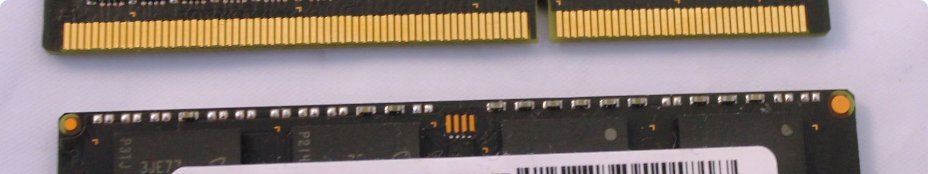
Importance of Memory Allocation
1
Efficient Resource Utilization
2
Preventing Issues
3
Supporting Dynamic Behavior
Effective memory management helps avoid memory leaks and fragmentation, which can lead to program instability and performance degradation.
Proper memory allocation ensures efficient use of available memory resources, preventing waste and maximizing performance.
Dynamic memory allocation enables flexible program behavior and the use of dynamic data structures, crucial for many applications.

Slide 4
Memory Allocation Algorithms
First-Fit
Best-Fit
Worst-Fit
The First-Fit algorithm searches for the first available memory block that is large enough to accommodate the requested size. It is simple to implement and generally fast but can lead to external fragmentation.
The Best-Fit algorithm searches for the smallest available memory block that can accommodate the requested size. This approach minimizes wasted space but can be slower due to the need to search the entire free list.
The Worst-Fit algorithm allocates the largest available block, leaving the remaining space for future allocations. This can be beneficial in some scenarios but may lead to increased fragmentation over time.

Slide 5

Memory Fragmentation
Internal Fragmentation
External Fragmentation
Internal fragmentation occurs when allocated memory blocks are slightly larger than requested, resulting in unused space within allocated blocks. This is often a consequence of fixed-size allocation schemes.
External fragmentation happens when free memory is divided into small, non-contiguous blocks. This can make it difficult to allocate large contiguous blocks of memory, even when the total free memory is sufficient.

Slide 6


Project Goals
1
Primary Goals
Implement a custom memory allocation system in C, develop efficient algorithms for allocation and deallocation, and minimize memory fragmentation.
2
Secondary Objectives
Implement memory coalescing, develop a comprehensive testing suite, analyze and optimize time and space complexity, and create clear documentation.

Slide 7


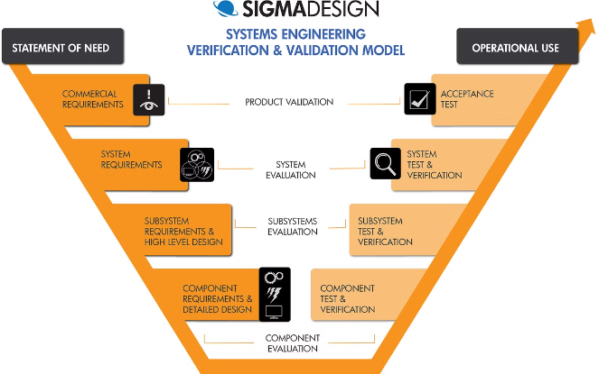



System Architecture
Memory Pool
A large pre-allocated chunk of memory that serves as the foundation for the allocator.
Free List
A data structure to track available memory blocks for efficient allocation and deallocation.
Allocation Function
Finds and allocates suitable memory blocks based on the chosen allocation strategy.
Deallocation Function
Frees memory and updates the free list, including coalescing adjacent free blocks.

Slide 8


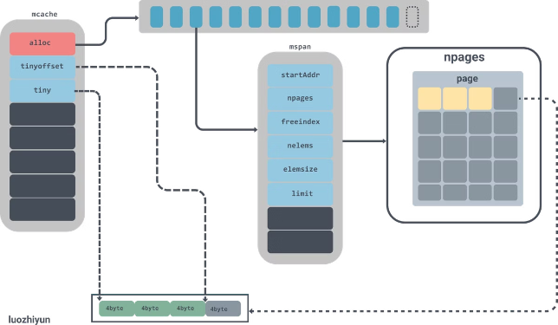


Key Algorithms
Memory Block Splitting
Dividing larger free blocks when allocating smaller amounts to minimize waste.
Memory Coalescing
Combining adjacent free blocks to reduce fragmentation and create larger contiguous free spaces.
Search Algorithms
Implementing First-Fit, Best-Fit, or Worst-Fit allocation strategies to find suitable free blocks.

Slide 9


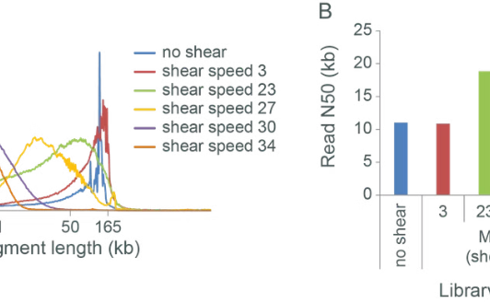
Benchmarking Results
Small Allocations
Large Allocations
Reduced Fragmentation
The custom allocator outperformed the standard malloc function by X% for small allocations (< 64 bytes).
The performance of the custom allocator was comparable to the standard malloc function for large allocations (> 1MB).
The custom allocator showed Y% less fragmentation compared to the standard library functions in long-running scenarios.

Slide 10


Conclusion and Future Enhancements
Achievements
Lessons Learned
- Developed a functional and efficient memory allocator - Implemented memory coalescing to reduce fragmentation - Created a comprehensive test suite ensuring reliability - Achieved performance comparable to or exceeding standard library functions
- Importance of careful design in systems programming - Trade-offs between different memory allocation strategies - Challenges in debugging and optimizing memory-related code - Complexity of managing fragmentation and ensuring efficiency
The project successfully implemented a custom memory allocation system in C, providing an alternative to the standard malloc() and free() functions. Future enhancements may include implementing additional allocation strategies, developing a multi-threaded version, and exploring techniques for managing very large memory pools.

Slide 11

Conclusion and Thank you
In conclusion, this custom memory allocation system has proven to be a reliable and efficient alternative to the standard library functions. We hope the insights and techniques shared here will inspire further innovation in systems programming.

